Slide 1
Three Approaches to Assessing Probability
Probability – a numerical value that represents the chance, likelihood, or possibility that an event will occur.
1 a priori classical probability
  based on prior knowledge
2 empirical classical probability
  based on observed data
3 subjective probability
  based on individual judgment or opinion about the probability of occurrence

Slide 2
Important Terms
Probability always lie between 0 and 1, where 0 means it will never happen, and 1 means it is certain to happen.
Consider a random experiment e.g. toss a coin: head or tails or roll a die- 1,2,3,4,5,6 coming up is determined by chance.
A simple event represents a single outcome of a random experiment, e.g. let event A be defined as a Head. So Prob (A)=0.5. Complement of an event A (denoted A’) is Prob(Not A).
Another event B, say is rolling a 3 Prob(B)=1/6.
B’ would be prob of rolling anything other than a 3.
0 ≤ P(A) ≤ 1 For any event A

Slide 3
A few more Important Terms
Mutually Exclusive Events- defined as Events that cannot occur together
i.e. you cannot toss a coin once and get both a head and tail.
Collectively Exhaustive Events- One of the events must occur
If A and B are mutually exclusive and collectively exhaustive: e.g. head, tail: prob(A) + prob(B)=1

Slide 4
A simple example: contingency table
 |  | Contingency table
 |  |  | Own a cat (A)
 |  |  | yes | no | total
 | Own a dog (B) | yes | 100 | 280 | 380
 |  | no | 320 | 300 | 620
 |  | total | 420 | 580 | 1000

Slide 5
Pets in the House
cat in house
320
dog in house
280
Neither 300
cat & dog
100

Slide 6
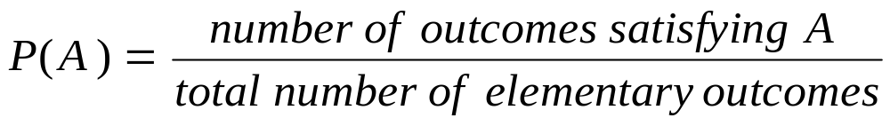
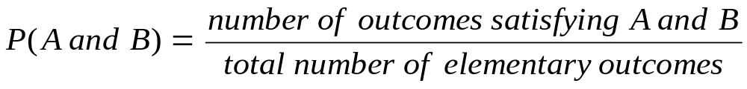
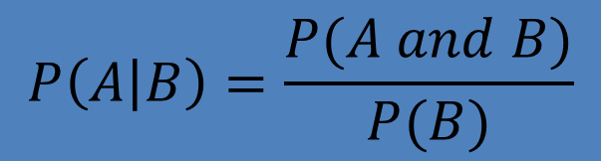
4. Rules of probability: Simple or marginal Joint Additive Conditional
$$P\left(A or B\right)=P\left(A\right)+P\left(B\right)−P(A and B)$$
$$P\left(A | B\right)=\frac{P(A and B)}{P(B)}$$

Slide 7
Your turn: work out:
Prob(cat), Prob(dog)
Prob(cat and dog)
Prob(cat or dog)
Prob(cat|dog)

Slide 8
Example
P(cat)= 420/1000=0.42
P(cat & dog)=100/1000=0.1
P(cat or dog)=p(cat)+p(dog)-P(cat & dog)
=420/1000 + 380/1000 -100/1000 =700/1000 =0.7
P(cat|dog)= p(cat & dog)/P(dog)
=0.1/0.38 =0.2632

Slide 9
To final important statistical concepts:
1. Events are they mutually exclusive?
2. Events are they statistically independent?

Slide 10
If A and B are mutually exclusive, then the rule
P(A or B) = P(A) + P(B) - P(A and B)
can be simplified since P(A and B) = 0, so
P(A or B) = P(A) + P(B)

Slide 11
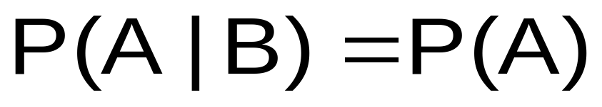
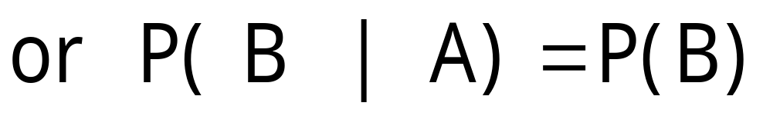
Statistical Independence
Two events are independent if and only if:
Events A and B are independent when the probability of one event is not affected by the other event
Example: in our cats(A) & dogs(B) example are A and B independent?

Slide 12
P(A|B)=0.26. P(A)=0.42
So they are NOT equal so not independent

Slide 13
Another Example: Independence
Let A be toss a coin and get a head P(A)=1/2
Let B be throw a die and get a 6 P(B)=1/6
Check is P(A|B) = P(A)?
Yes so independent

Slide 14
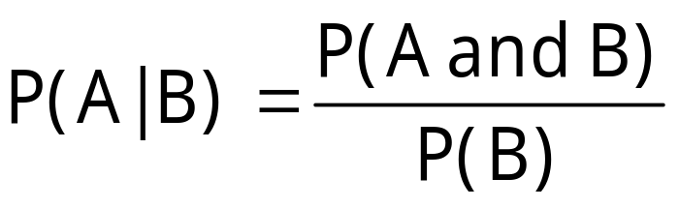
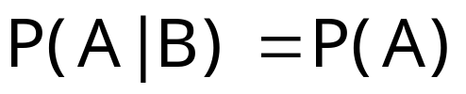

Multiplication Rule (once again)
Recall
Multiplication rule for two events A and B:
Also recall if A and B are independent
and therefore multiplication rule simplifies to:

Slide 15
Using Decision Trees
A Decision Tree:
is an alternative to contingency tables
allows calculation of joint probabilities by
multiplying respective branch probabilities
I am going to arbitrarily write down the tree as cat then dog. You could have dog then cat –your probabilities would be identical.
Personally I MUCH prefer the contingency table (unless there is an obvious timing i.e. sequential dimension to the decisions)

Slide 16
Decision tree
1000 Melbourne/Singapore
Cat P(A)=.42
Cat and Dog P(A&B)=0.1
Cat and No Dog P(A & B')=0.32
No Cat P(A')=0.58
No Cat but Dog P(A' & B)=0.28
No Cat and No Dog P(A'&B')=0.3

Slide 17
Bayes’ Theorem
A technique used to revise previously calculated probabilities with the addition of new information
Classic example: Deadly disease (D): new info a positive blood test result (P)
Let P(D)=0.03 is the probability you have a deadly disease – so very unlikely!(pheeewwww)
Let P(P|D)=0.9, that is the probability of a positive test result given you have the disease. (you would like this to be =1, but tests are NOT perfect)
Let P(P|D’)=0.02 This means the probability of a positive test result, given you don’t have the disease. (that’s called a false positive!) pretty nasty!
So what is P(D’) and P(P’|D)? 0.97 and 0.1.

Slide 18
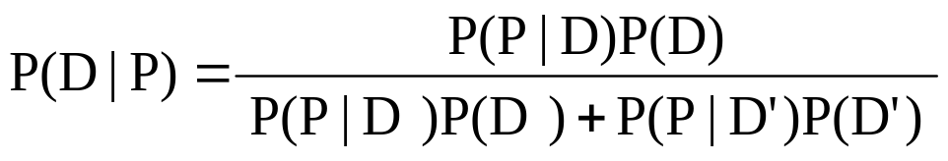
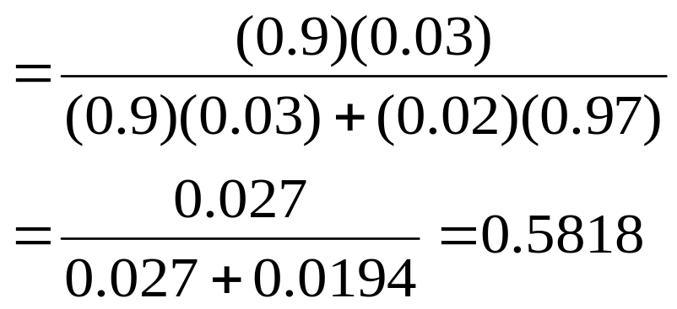
Bayes’ Theorem
This formula allows us to update our subjective probability of having the disease now that we have a positive test results. Plug in the probabilities and calculate:
_{P(D|P)=}
You can see you revise the prob of having the deadly disease UP massively

